Slide 1
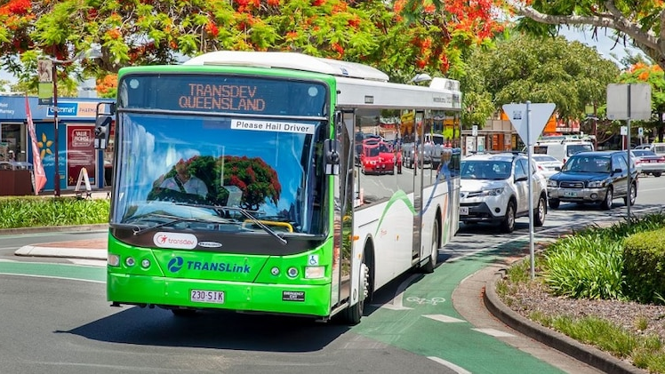

Beyond the Bus Stop Insights into Brisbane’s Public Transport
Group 18 – Greg, Linh, Haoqing, Miya, Chaitanya, Wilson
https://www.abc.net.au/listen/programs/brisbane-drive/electric-bus-comes-to-redland-city/13208392

Slide 2


















Problem solving with data
Is my data fit for use?
Story telling with data
Getting the data we need
Making the data confess

Slide 3
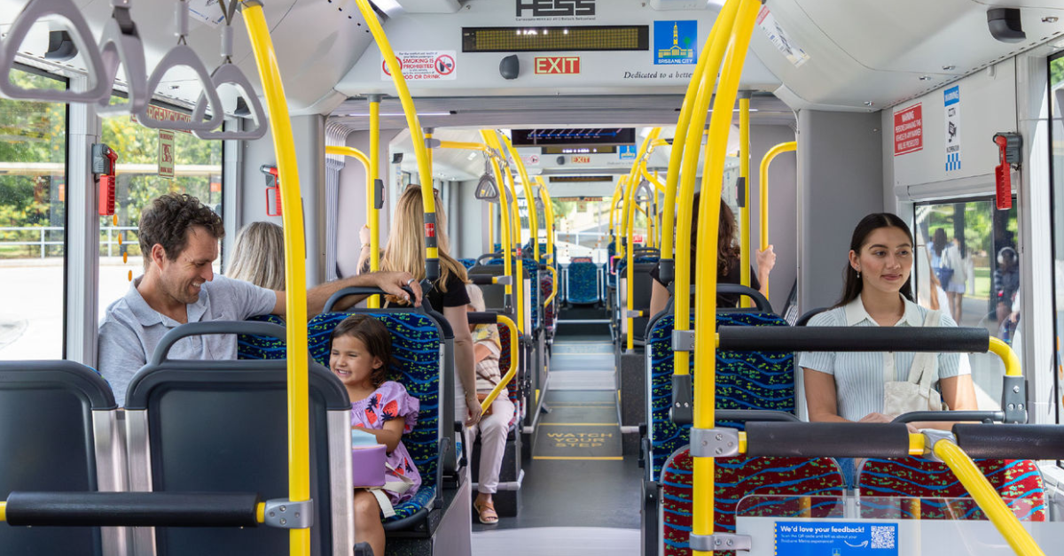

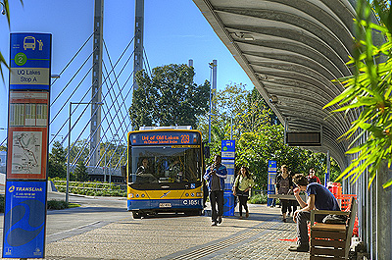

As UQ students reliant on public transport, we aim to use data to improve efficiency, match services to demand, support planning, and study weather impacts on commuters.
How do weather conditions impact on the trip volume?
How do people from different
suburbs use public transport?
Can we forecast future trip volumes?
Problem Solving
with Data
Motivation

Slide 4




Dataset Dimensions
Files | Rows | Columns
38 | 300-500K each | 9
1 | 16932 | 5
3 | 2.6M | 11
Getting the Data I Need
Origin Destination Trips 2022-2025
Origin Destination Stop Locations Jan 2022-Feb 2025
Translink Time Table (current)
Weather Observations Brisbane City (Queensland) from April 2024 to March 2025
12 | 28-31 each | 21
2021 Census Data pack - General Community Profile (Postal Areas)
1 | 433 | 109
Brisbane Suburb Boundaries (Arcgis)
1 | 195 Suburbs

Slide 5
Missing Not At Random
Fare Evasion
No ticket = No trip recorded.
Smart Ticketing
Smart Ticketing Trips are not recorded (system limitation).
Affects:
Rail - Mid-2022+
Ferry - April 2024+
Bus - March 2025+
Missing at Random
Paper Tickets
Destination not recorded. (Records dropped)
Missing Completely at Random
Missing Weather Observations.
Variables dropped if too many missing (eg Wind Gusts).
2
Is my Data Fit for Use?
Missing Data
Notes:
The Origin Desination Trip data is based on paper ticket purchases and Go Card tap on/tap off. If a fare evader doesn’t pay for a ticket or use a Go Card then we have no record of the trip.
Translink has been rolling out a Smart Ticketing platform across its network since Mid-2022. The available data does not include trips where a traveller has used the Smart Ticketing system. Bus data used in this study is unaffected as Smart Ticketing went live on March 26. We largely focus on that as a result. Both of these issues are examples of data Missing Not at Random.
Paper ticket purchases often don't record the destination location. This data is missing at random. We chose to drop records with missing destination locations as it was less than 1% of the total dataset.
Heavy anonymisation has been applied with aggregation of trip data to monthly totals across only 5 broad time periods. Full details of trip origin and destination are retained.
Daily from the Bureau of Meteorology contains some missing observations that we believe are missing completely at random. We have dropped missing data if there was only a few observations missing rather than trying to impute their values.

Slide 6
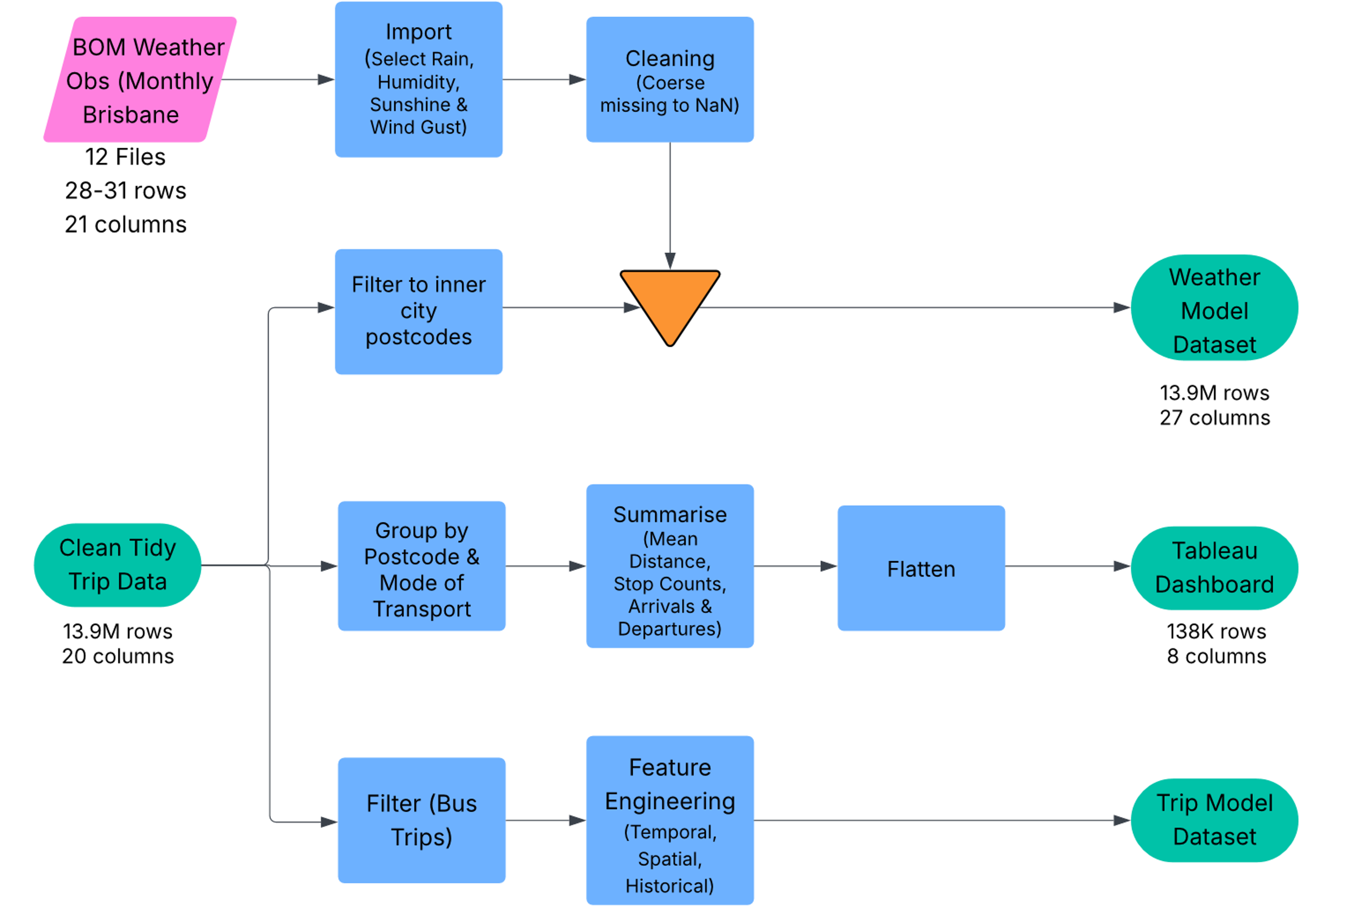
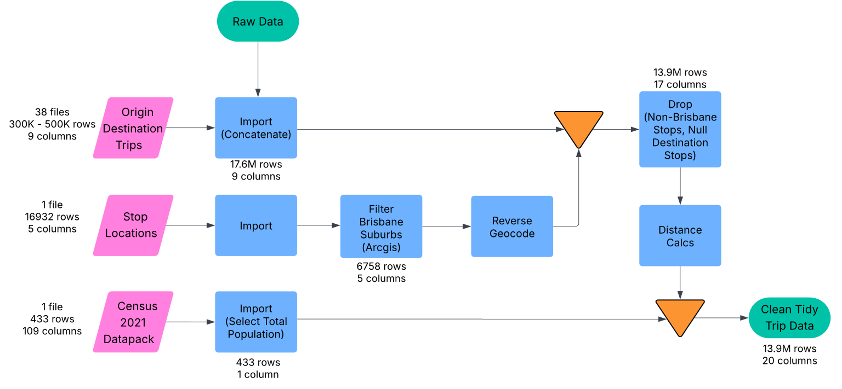
Is my Data Fit for Use?
Data Processing
Notes:
38 Monthly Origin Destination Trips datasets were imported and concatenated to yield a dataset with 18 million rows The Stop location datafor South East Queensland was filtered using an Arcgis file, retaining stops contained within the boundaries of Brisbane and then joined with the trip data. Records with non-Brisbane stops were dropped.
Reverse Geocoding via the Google Maps API determined the Postcode/Suburb for a stop and the point to point trip distance was calculated using Geopy. Total population data from the Australia Bureau of Statistics 2021 Census was joined by postcode resulting in a clean and tidy dataset.
Three datasets were generated from this for weather analysis, modelling and trip visualisations.
Daily Weather observations for 12 months were imported for Brisbane City only and joined with trip data for inner city Brisbane postcodes that would have experienced the same weather as the weather station.
Dashboard data was grouped by mode of transport, postcode and time period before being summarised to calculate the number of stops, mean distance travelled, and the total number of people arriving and departing.
The Modelling dataset was filtered to just focus on bus trips. Feature engineering focused on three aspects: Temporal, Spatial and Historical aspects to give the models something to work with.

Slide 7
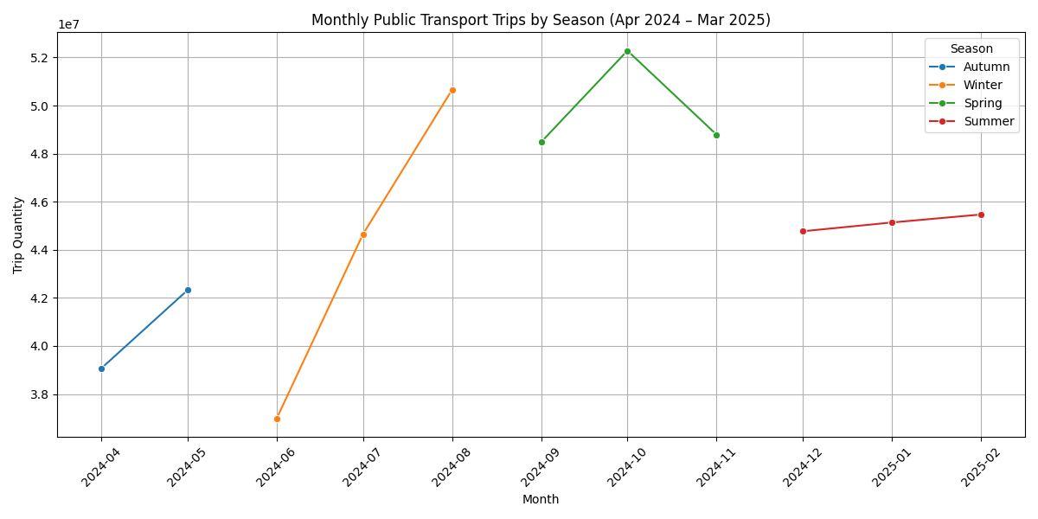
Research Area 1: Does weather conditions have an impact on the trip volume?
Let us analyze a seasonal trend of ridership over a year (Apr '24 to Mar '25)
EXPLORATORY
DATA
ANALYSIS
Key Observations: Autumn: Lowest trip volumes Winter: Highest trip volumes, peaking in August Spring: Maintains consistently high usage with moderate fluctuation Summer: Shows moderate but steadily increasing trip volumes. Dips in December.
Notes:
Making data confess

Slide 8
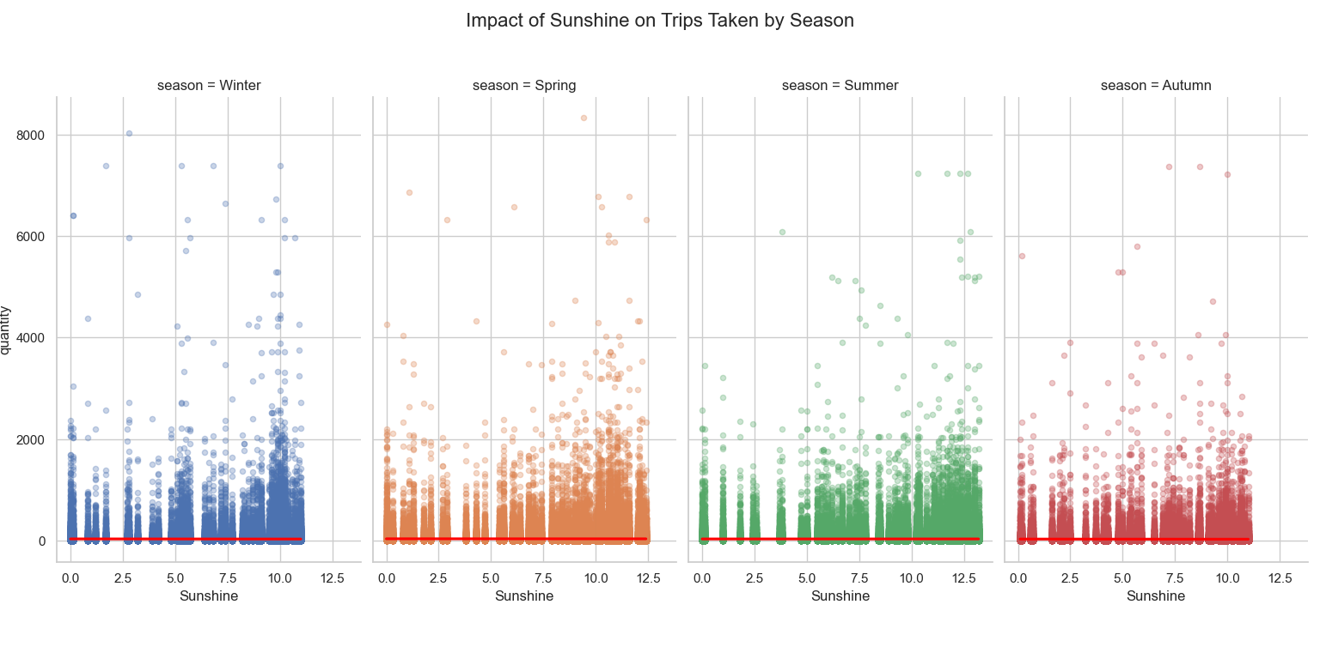
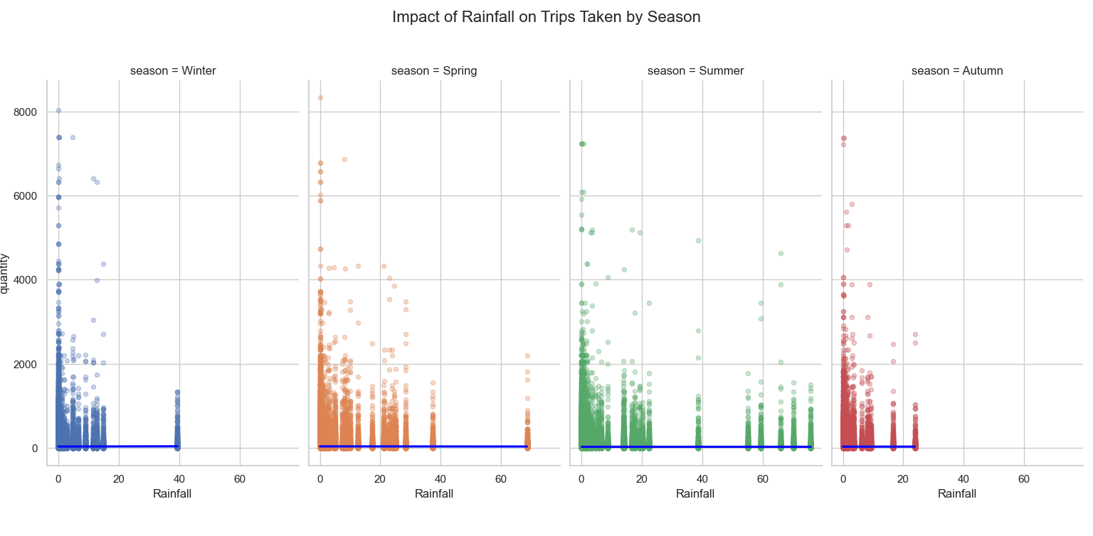
Research Area 1: Does weather conditions have an impact on the trip volume?
Let us analyze the influence of sunshine and rainfall on trip volume (per season)
EXPLORATORY
DATA
ANALYSIS
Notes:
Making data confess

Slide 9
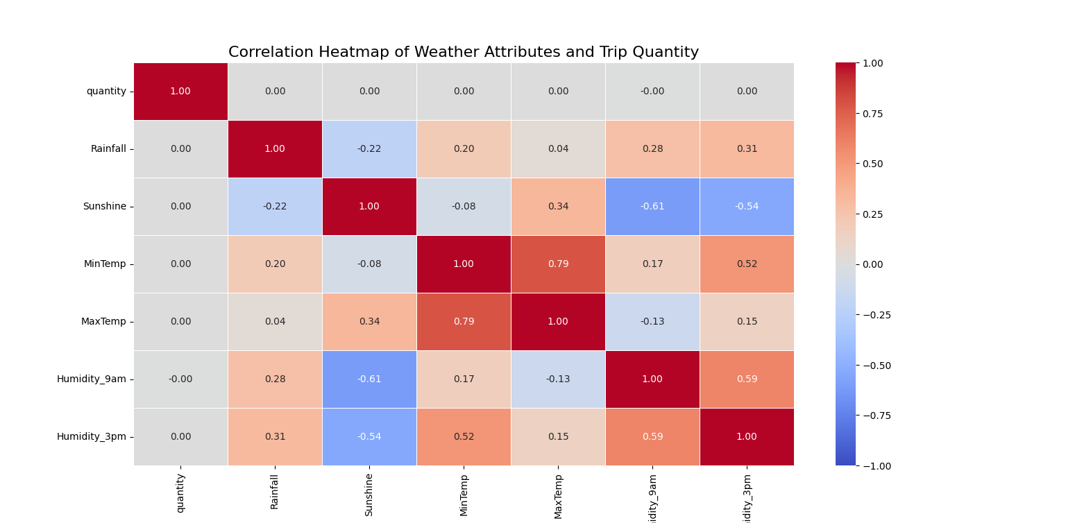
Research Area 1: Does weather conditions have an impact on the trip volume?
Let us analyze the correlation between weather factors and public transport trips
Variables | Coefficient | Std Error | t-value | p-value | 95% CI
Intercept | 35.3003 | 0.100 | 351.422 | 0.000 | [35.10, 35.50]
Sunshine | 0.0748 | 0.011 | 6.897 | 0.000 | [0.054, 0.096]
Rainfall | 0.0150 | 0.004 | 4.143 | 0.000 | [0.008, 0.022]
R-squared =0.000 (indicates weather does not explain variation in trip count)
F-statistic =27.46 (significant, but very tiny effect)
Number of observations: 13.86 million
Notes:
Making data confess

Slide 10
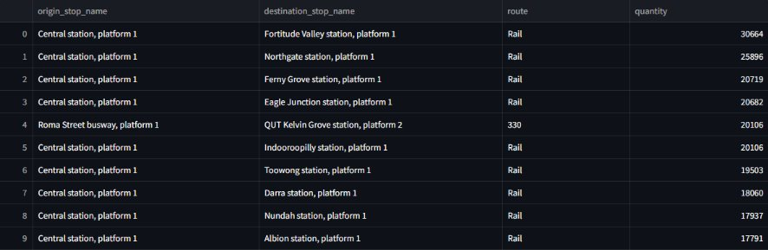
Purpose : Understand how people are commuting from different suburbs using public transport
Transport Type? E.g. Bus/Train/Ferry​
Transport Route? E.g. Bus 412​
How many transfers made?​
Popular routes/stops?
Research Area 2: How people from different suburbs use public transport?
E.g. Top 1% of Trips for Brisbane City
EXPLORATORY
DATA
ANALYSIS
Notes:
Making data confess

Slide 11
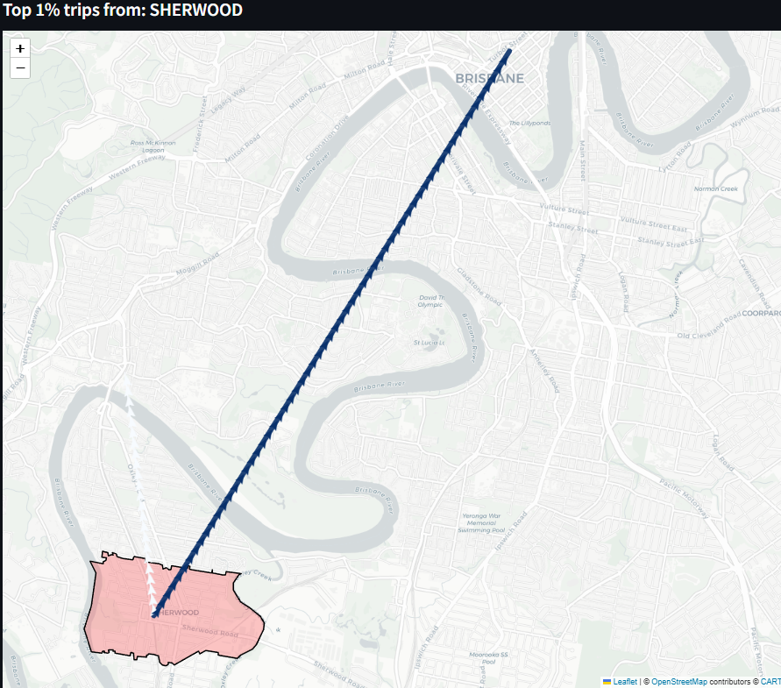
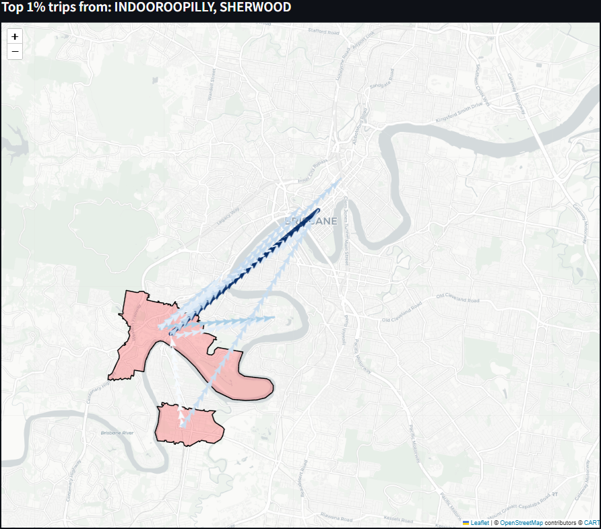
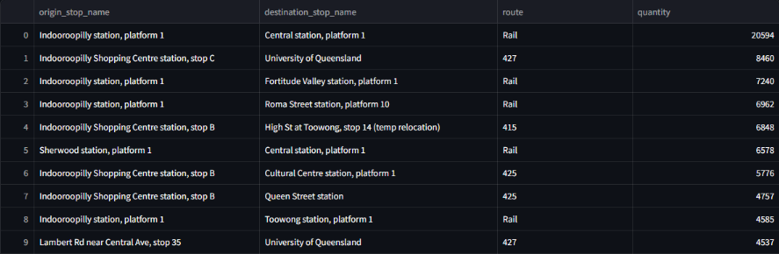
E.g. Suburb Sherwood

Slide 12
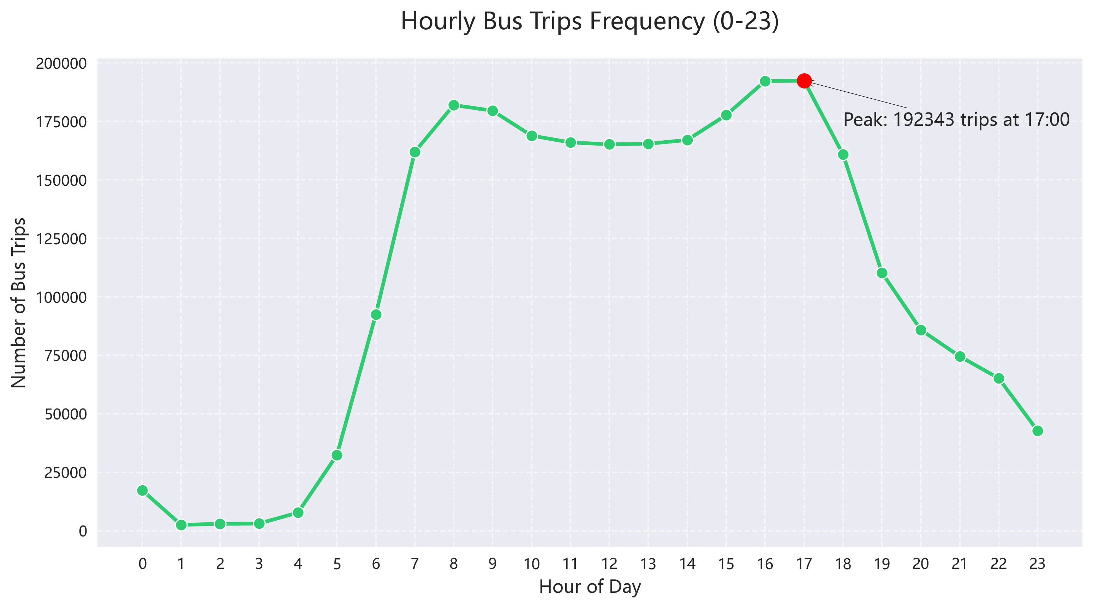
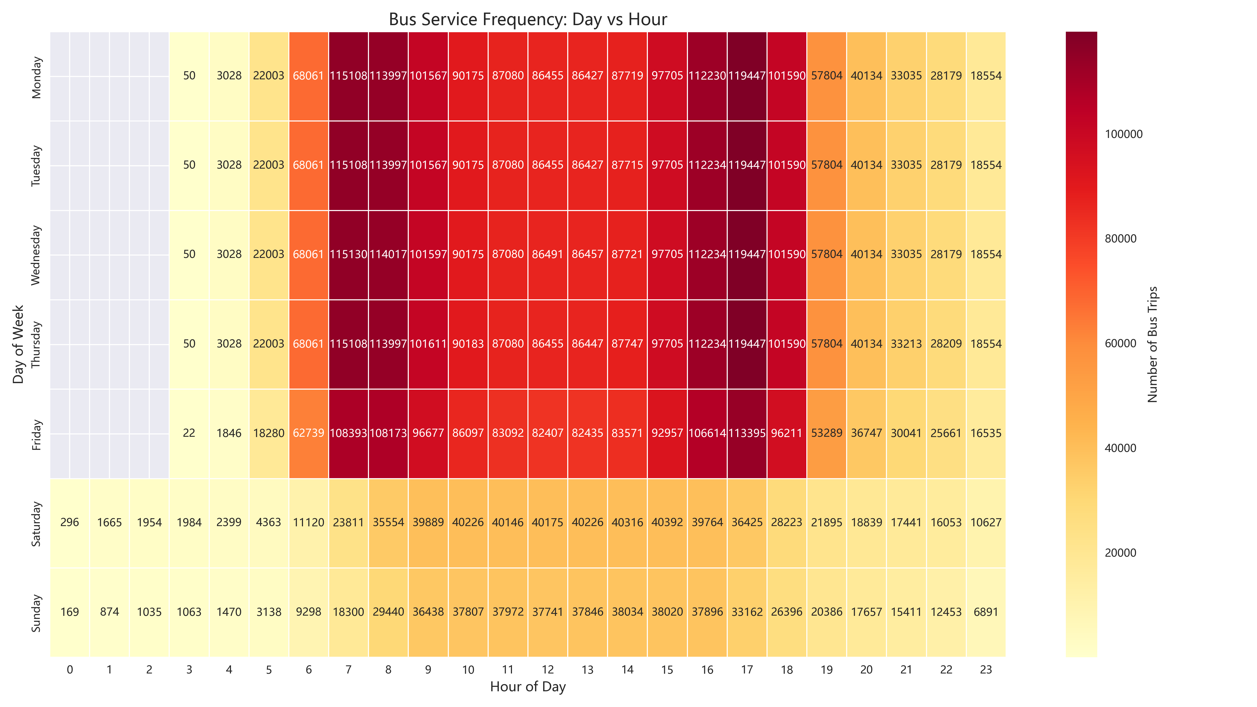
Research Area 2: How people from different suburbs use public transport?
EXPLORATORY
DATA
ANALYSIS

Slide 13
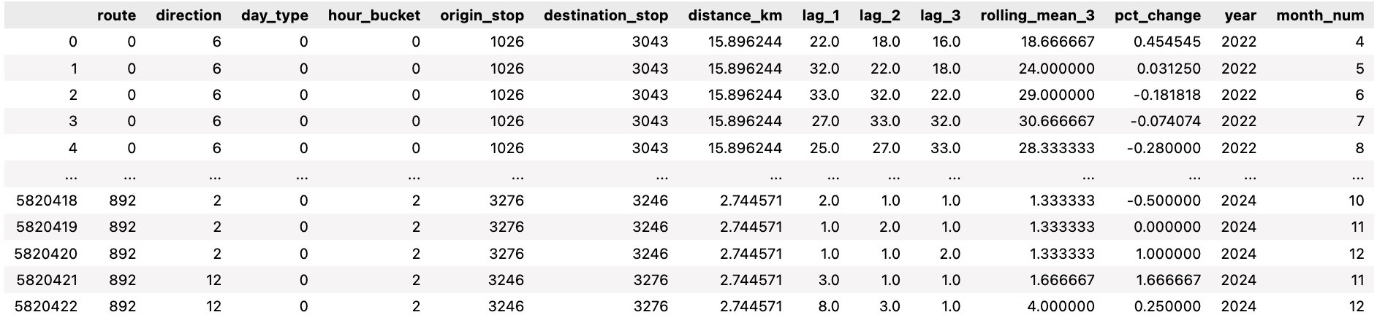
Training Setup
All models were trained on a preprocessed and feature-engineered dataset that included:
Temporal features (day type, hour bucket, month)
Spatial identifiers (route, direction)
Historical trends (lagged passenger counts, rolling means, percentage changes)
Train-Test Split
To simulate real-world forecasting, the dataset was split chronologically:
Training set: All data from 2022 to 2024 (5820423 rows)
Test set: All data from 2025 (432883 rows)
Research Area 3: Passenger Demand Forecasting
MAKING THE DATA CONFESS
Model Selection Rationale
Four models were chosen to represent varying levels of complexity:
Linear Regression, Decision Tree, XGBoost, LightGBM
These models help compare simple vs. advanced approaches on the same dataset, balancing accuracy and complexity.

Slide 14
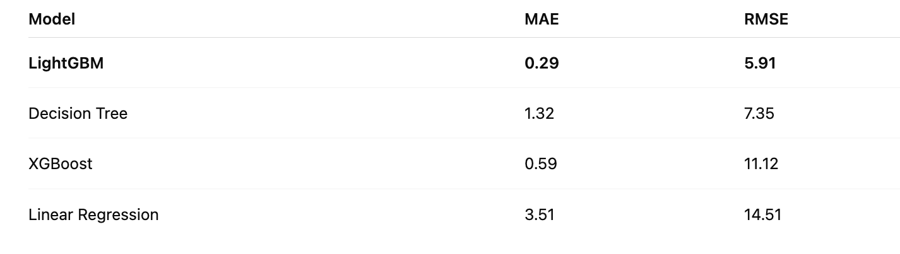
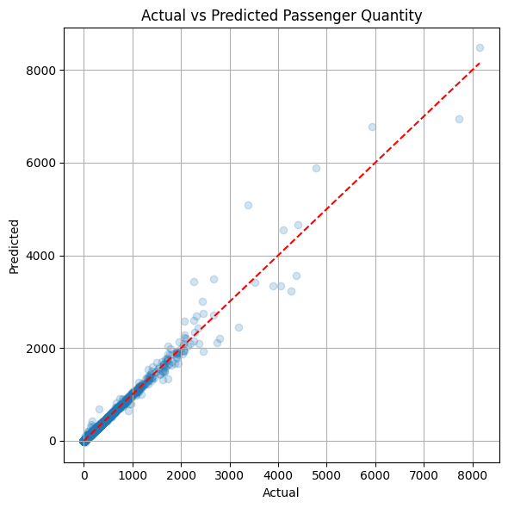
Results & Insights
Models Comparision
LightGBM outperformed all models, accurately capturing temporal, spatial, and trend-based patterns
Linear Regression served as a baseline but lacked capacity for non-linear patterns.
Decision Tree and XGBoost offered moderate gains but were less consistents
Research Area 3: Passenger Demand Forecasting
MAKING THE DATA CONFESS
Prediction Accuracy – LightGBM
Predictions closely align with actual values along line, indicating strong overall model performance.
Accuracy is high for typical demand levels, with minimal deviation.

Slide 15
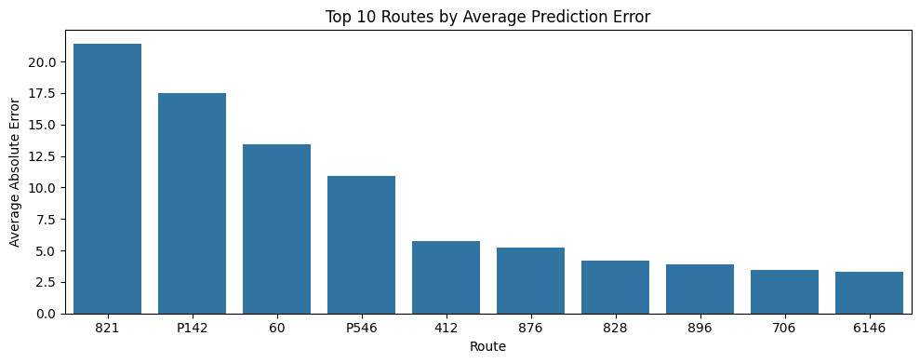
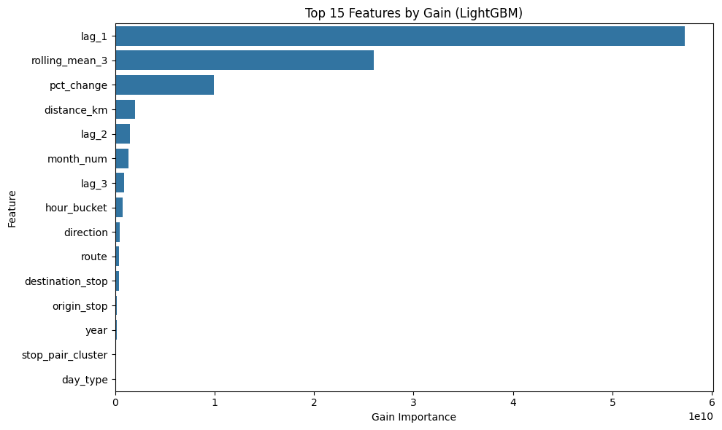
Route-Level Error Analysis
Unstable demand patterns contribute to high prediction errors on certain routes.
Limited historical data reduces model accuracy for less frequently used or newer routes.
External factors changes should be considered for high-error routes.
Research Area 3: Passenger Demand Forecasting
Feature Importance (Gain-Based)
The model relied most on temporal trend features, highlighting the importance of recent demand and short-term patterns. Spatial features and day_type contributed little, suggesting that time-based variables already captured their effects.
MAKING THE DATA CONFESS

Slide 16
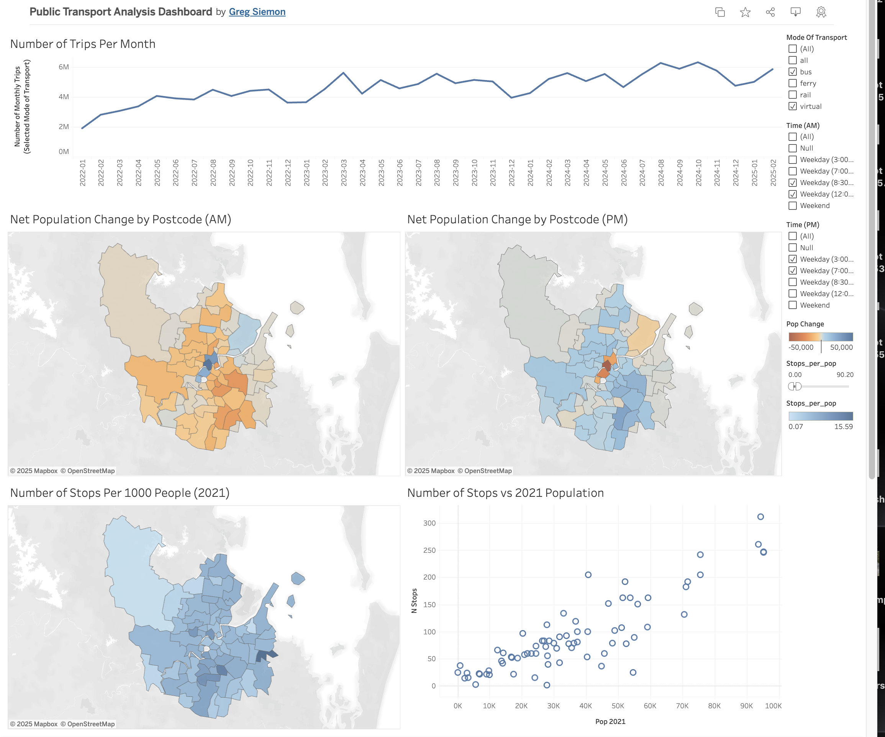
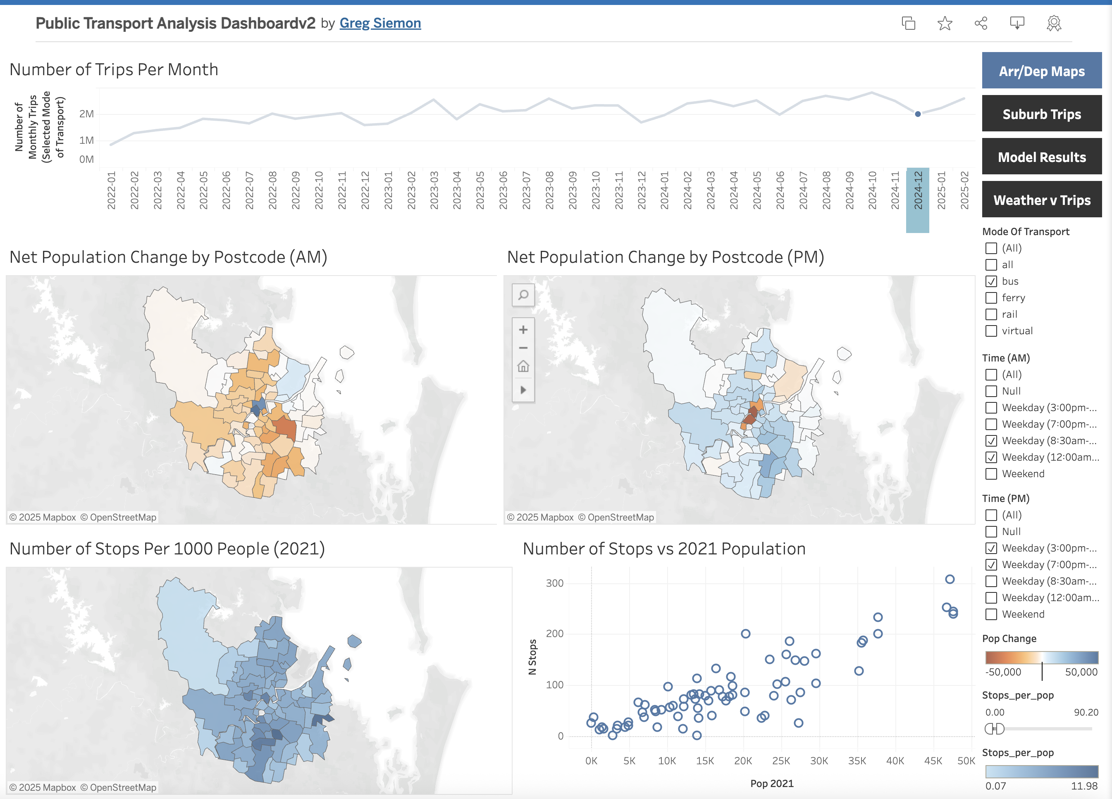
Storytelling with Data
Tableau Dashboard (Demo)
Link

Slide 17
Storytelling with Data
Recommendations
Align service levels with routine patterns (eg. school terms, work peaks)
Consider increasing the number of stops in areas with <6 stops per 1000 population. Lack of access may be contributing to low number of trips. - Translink
Connect Tableau to a Database (flat files too big for it to handle reliably)
Further Study
Include more variables: day of week (weekend/weekday, holidays, local events, school calendars etc)
Explore lag and extreme weather impacts
Trip segmentation: leisure vs commute ( Regular commuters travel regardless of the weather whereas leisure trips are likely to be affected by poor weather)
Estimate Missing Data – eg fare evaders, smart ticking, etc
Integrate timetable analysis with trip data.
Recommendations
and Further Study

